Slide 1
Course Introduction
& Data Exploration
MAR 536 Biological Statistics II
January 26 2016

Slide 2
Overview Lecture
Roster
Course Description (syllabus)
  Objectives
  Text (1. Introduction)
  Evaluation Procedures
  Schedule
Chapter 2. Data Management & Software
Chapter 4. Data Exploration
Overview of Methods
Advanced Stats
Introduction

Slide 3
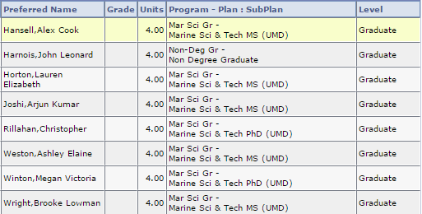
Roster
Silva, Tammy
Advanced Stats
Introduction

Slide 4
Course Description
Student-led learning in statistical analysis of ecological data.
  This course provides guided learning in advanced statistical analysis, as applied to ecological research and other fields of marine science.
  Advanced concepts in probability, hypothesis testing, and estimation will be presented by students, including analyses of example data sets and problems.
  Students will be required to learn selected methods independently, present topics to the class that are relevant to their graduate research and complete a class project.
A computer lab, focused on introductory and intermediate programming and analysis using R, will be held for the first half of the semester.
Advanced Stats
Introduction

Slide 5
Course Objectives
Self-learning in advanced quantitative concepts and methods
Familiarity with advanced statistical methods
Experience communicating advanced quantitative topics
Experience in statistical programming
Advanced Stats
Introduction

Slide 6
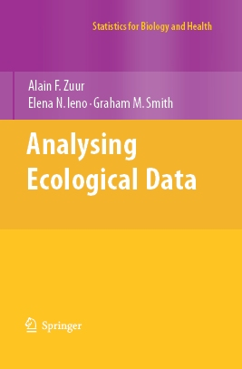
Text
Zuur, A.F., Ieno, E.N. and Smith, G.M. (2007). Analysing Ecological Data. Springer. 700p. Series: Statistics for Biology and Health.
Two parts:
  Statistical theory (Chap’s 1-19)
  Case studies (Chap’s 20-37)
Advanced Stats
Introduction

Slide 7
1 Introduction
Many ecologists don’t have statistical support and must learn advanced methods independently.
Aim of the book (and the class): Introduce advanced techniques to statistically literate ecologists. Presentations are ‘ecologist friendly.’
The required background for this book (and this class) is familiarity with basic statistics:
  Normal distribution
  P-value
  Correlation
  Regression
  Hypothesis testing
Independent statistical programming and debugging.
Advanced Stats
Introduction

Slide 8
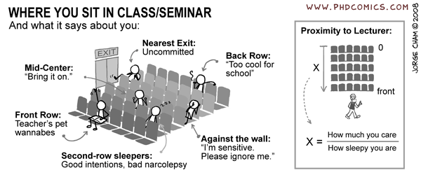
Evaluation Procedures
Advanced statistical analysis (55%)
Student lecture (30%)
Participation in discussion (5%)
Computer Lab Assignments (10%)
Advanced Stats
Introduction

Slide 9
Evaluation Procedures
An advanced statistical analysis of data relevant to your graduate research topic, including a detailed report and oral presentation (55% of course grade).
  A brief description of the topic including a statement of the problem, proposed statistical method, and supplemental reference(s) is due February 25 (5% of course grade).
  A presentation on the project will be given at the end of the semester (25% of course grade).
  A project report (<10 pages of text) is due at the end of the semester. The report should include an introduction with concise background and statement of objectives, methods, results and discussion (25% of course grade).
Advanced Stats
Introduction

Slide 10
Content of Project
(Zuur et al. 2007 page viii)
Problem Statement:
  These are my questions: …
  This is my statistical approach: …
Presentation & Report:
  Here’s proof that I did it all correctly (model validation): …
  This is what the data show: …
  Here is the ecological interpretation: …
Advanced Stats
Introduction

Slide 11
Evaluation Procedures
Student Lecture (30% of grade)
  Chapter assignment or supplemental reading on a statistical topic relevant to students’ graduate research, including a one-hour lecture on assigned reading, including introduction of the method, demonstration of the method using example datasets, and leading class discussion.
  Case studies described in the 2nd part of the book should be used for demonstrations (data and R code are online at www.highstat.com/book1.htm).
  Presentations will be graded based the instructor’s evaluation of accuracy, clarity and comprehensiveness.
  Feedback from other students and guest lecturers will also be considered in evaluation of presentations.
Participation in Class Discussions (5% of grade)
Advanced Stats
Introduction

Slide 12
Class/Lab Schedule
Lectures: Tuesday/Thursday 10:30-11:45
  All semester
Labs: Wednesday 10:30-12:30
  January 27 to March 9
Advanced Stats
Introduction

Slide 13
Schedule of Lectures – Part 1
Type | Day | Date | Reading | Topic | Presenter
Lecture | Tue | Jan 26 | Zuur et al. Chap. 1-4 | Introduction, data exploration | Steve
Lab | Wed | Jan 27 |  | Introduction to R and R Studio, working with data | Gavin
Lecture | Thur | Jan 2 | Bolker 2008 Chap. 4 | Probability review | Gavin
Lecture | Tue | Feb 2 | Zuur et al. Chapter 5 | Linear regression review | Steve
Lab | Wed | Feb 3 |  | Introduction to plotting, manipulating data | Gavin
Lecture | Thur | Feb 4 | Zuur et al. Section 6.1 | Extending linear model (GLM) | Steve
Lecture | Tue | Feb 9 | Zuur et al. Section 6.2 | Classification, Logistic regression | Steve
Lab | Wed | Feb 10 |  | Probability, Linear modeling in R, PCA. | Gavin
Lecture | Thur | Feb 11 | Zuur et al. Chapter 12 | Matrix algebra review and PCA | Steve
Lecture | Tue | Feb 16 | NO CLASS | Monday schedule
Lab | Wed | Feb 17 |  | Programming practices, conditional statements | Gavin
Lecture | Thur | Feb 18 | Zuur et al. Chapter 14 | Linear Discriminant Analysis | Steve
Lecture | Tue | Feb 23 | James et al. Chapter 7 | Nonlinear models, splines | Gavin
Lab | Wed | Feb 24 |  | Creating functions, debugging | Gavin
Advanced Stats
Introduction

Slide 14
Tentative Schedule of Student Lectures
Type | Day | Date | Reading | Topic | Presenter
Lecture | Thur | Feb 25 | Zuur et al. Chapter 7 | GAMs Project descriptions due | Alex
Lecture | Tue | Mar 1 | James et al. Chapter 5 | Resampling methods, Cross-Validation | John/Lauren/ Arjun?
Lab | Wed | Mar 2 |  | Permutation analysis | Gavin
Lecture | Thur | Mar 3 | Zuur et al. Chapter 9 | Trees 1 | John/Lauren/ Arjun?
Lecture | Tue | Mar 8 | Zuur et al. Chap. 11-15 | Ordination | Ashley
Lab | Wed | Mar 9 |  | Advanced plotting | Gavin
Lecture | Thur | Mar 10 | James et al. Section 10.3 | Cluster Analysis | John/Lauren/ Arjun?
Lecture | Tue | Mar 22 |  | Project Feedback | Steve
Lecture | Thur | Mar 24 |  | Project Discussions | Steve
Lecture | Tue | Mar 29 |  | Presence-Only Discrimination | Tammy
Lecture | Thur | Mar 31 |  | Bayesian Methods | Chris
Lecture | Tue | Apr 5 | NO CLASS
Lecture | Thur | Apr 7 | NO CLASS
Lecture | Tue | Apr 12 |  | Analysis of Categorical Data | Brooke
Lecture | Thur | Apr 14 | Zuur et al. Chapter 19 | Spatial statistics (Gaussian spatial processes) | Megan
Advanced Stats
Introduction

Slide 15
Student Presentations
Type | Day | Date | Reading | Topic | Presenter
Lecture | Tue | Apr 19 |  | Review | Steve
Lecture | Thur | Apr 21 |  | Presentations
Lecture | Tue | Apr 26 |  | Presentations
Lecture | Thur | Apr 27 |  | Presentations
Lecture | Tue | May 3 |  | Presentations
Advanced Stats
Introduction

Slide 16
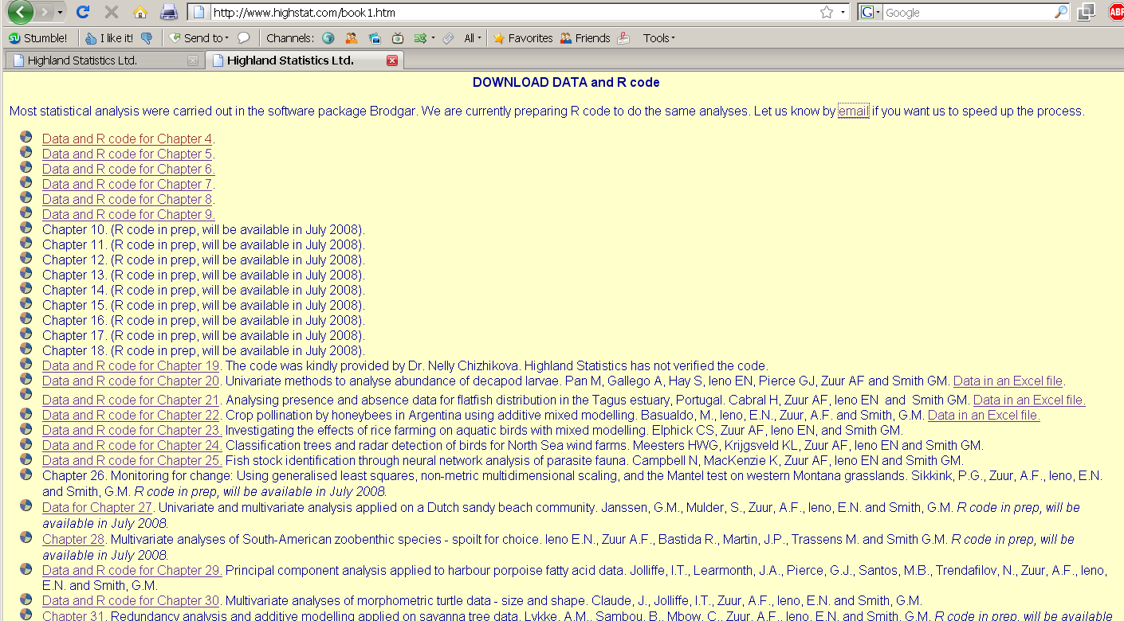
www.highstat.com/book1.htm
Advanced Stats
Introduction

Slide 17







2. Data Management & Software
Statistical software:
  Choice of software is largely unimportant
  …, but they may have different default settings or algorithms and give results.
  You can use whatever software you choose for this class (DIY technical support).
Your data are priceless:
  Expensive to collect
  Loss or corruption of data can be a disaster
Statistics courses generally focus on experimental design, representative sampling and analytical approaches.
Data recording, entry, audit, storage and ‘collation’ are typically ignored.
Advanced Stats
Introduction

Slide 18

Database Design
Spreadsheets are convenient for small data sets but are inefficient and problematic for larger, more complicated databases (e.g., loss of data, lack of repeatability).
Relational databases (SQL) support:
    Consistent, quick and accurate data entry
    Quality control (valid range, cross-checking)
    Efficient, secure data storage (relational, linked, indexed, backups)
    Supports repeatable, complex data queries
    Documented ‘metadata’ (table descriptions, variable definitions, code keys)
Advanced Stats
Introduction

Slide 19
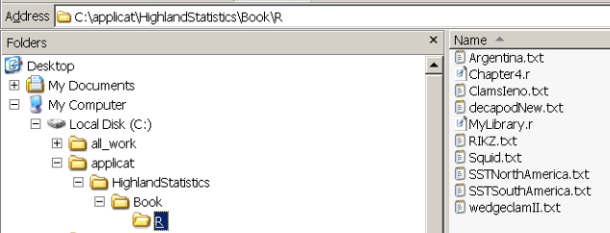
Chapter 4. Data Exploration
4.1 The first steps
  Boxplots
  Dotplots
  Histograms
  QQ-plots
  Scatterplots
  Pairplots
  Coplots
  Lattice graphs
  Design plots
  Interaction plots
4.2 Outliers, transformations and standardizations
4.3 A final thought on data exploration
www.highstat.com/book1.htm
Advanced Stats
Exploration

Slide 20
Overview of Bivariate Methods
Transformation
- response variable?
explanatory variable?
- residuals?
Normality
- histograms
- Q-Q plots
Collinearity
-pairplots
PCA
coplots
Lattice plots
Data
Exploration
Outliers
- dotplots
- boxplots
Linear relationships
Nonlinear relationships
Linear
Regression
Additive
Modeling
Verify linearity or nonlinearlity
violation of
homogeneity
violation of
homogeneity
Generalized
Linear Modeling
Generalized
Additive Modeling
Advanced Stats
Exploration

Slide 21
Overview of Multivariate Methods
Data
Exploration
not too
many zeros
Discriminant
Analysis
linear
relationships
known
group
membership
Principal
Component
Analysis
unimodal
explanatory
variables
Canonical
Correspondence
Analysis
Correspondence
Analysis
Redundancy
Analysis
unimodal
lots of
zeros
correlated variables
R-Technique
Principle Coordinate Analysis
Nonmetric Multidimensional Scaling
correlated observations
explanatory
variables
Q-Technique
- Mantel test
- Analysis of Similarities
Advanced Stats
Exploration

Slide 22
Basic Questions
Where are the data centered?
How are they spread? Are they symmetric, skewed, bimodal?
Are there outliers?
Are the data normally distributed?
Are there relationships between variables? Are relationships linear? Which analyses should be applied?
Is a transformation needed?
Was the sampling effort approximately the same for each observation or variable?
Expecting >20% of your research time exploring your data makes analysis easier and more efficient.
Advanced Stats
Exploration

Slide 23
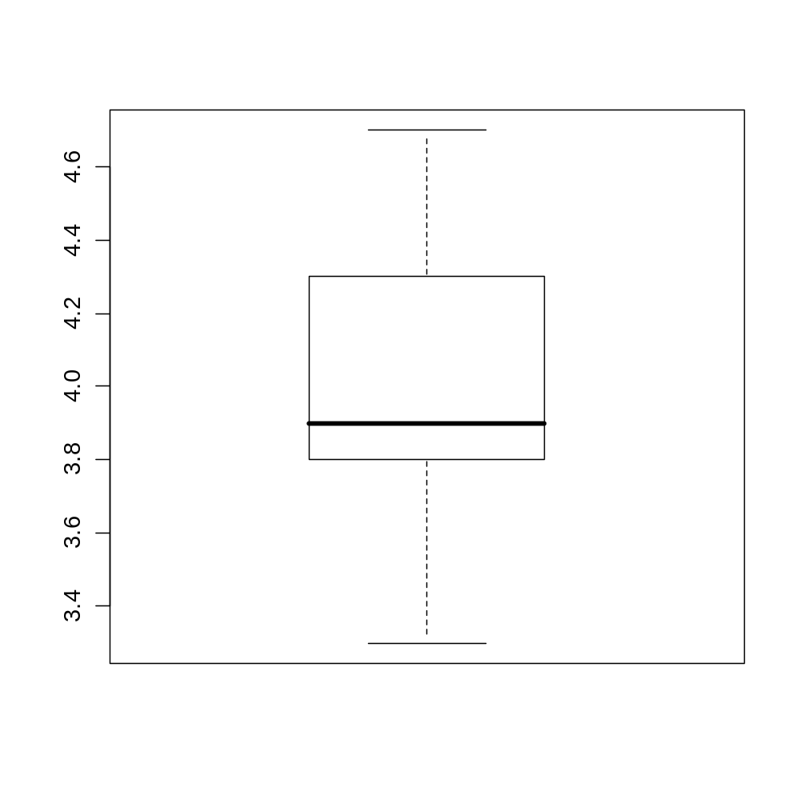
Boxplot
Whisker (maximum)
  (if max<hinge+1.5xspread)
Hinge (75th %ile)
Median
Hinge (25th %ile)
Whisker (minimum)
  (if min>hinge-1.5xspread)
Spread
(interquartile range)
Advanced Stats
Exploration

Slide 24
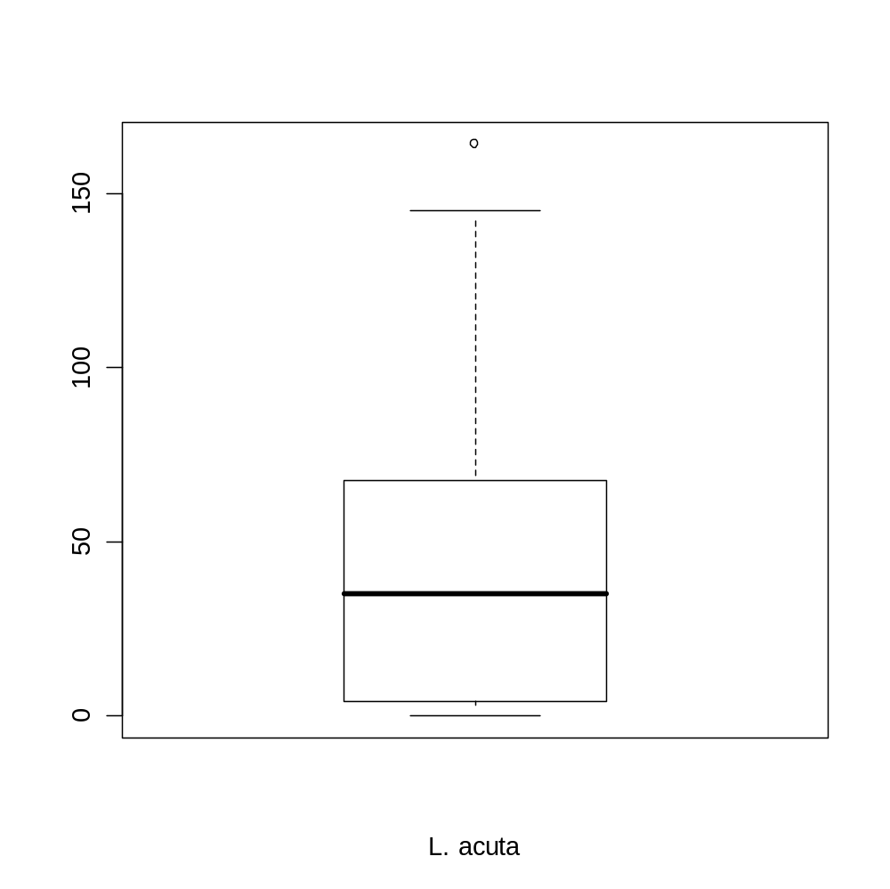
Boxplot with Outlier
Maximum (outlier)
Whisker
  (hinge+1.5xspread)
75th %ile
Median
25th %ile
Minimum
Number of ragworms
Advanced Stats
Exploration

Slide 25
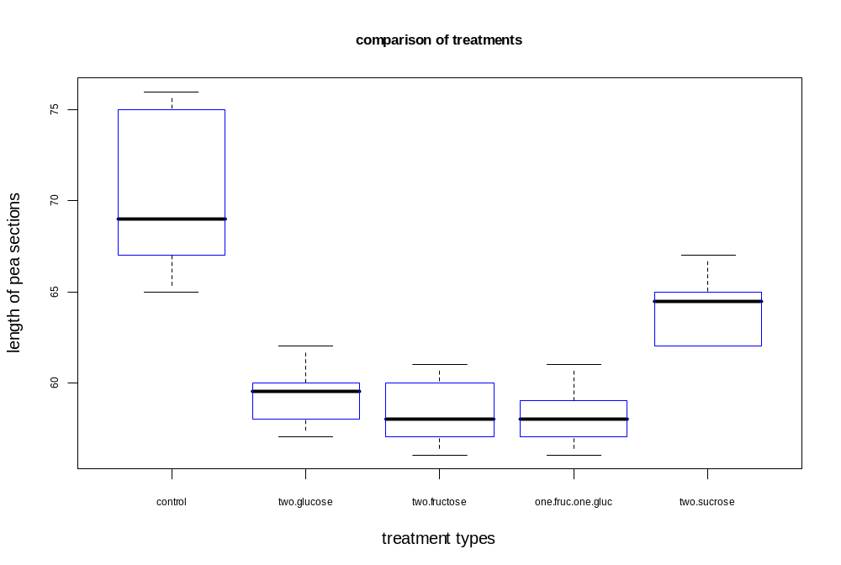
Conditional Boxplots
Advanced Stats
Exploration

Slide 26
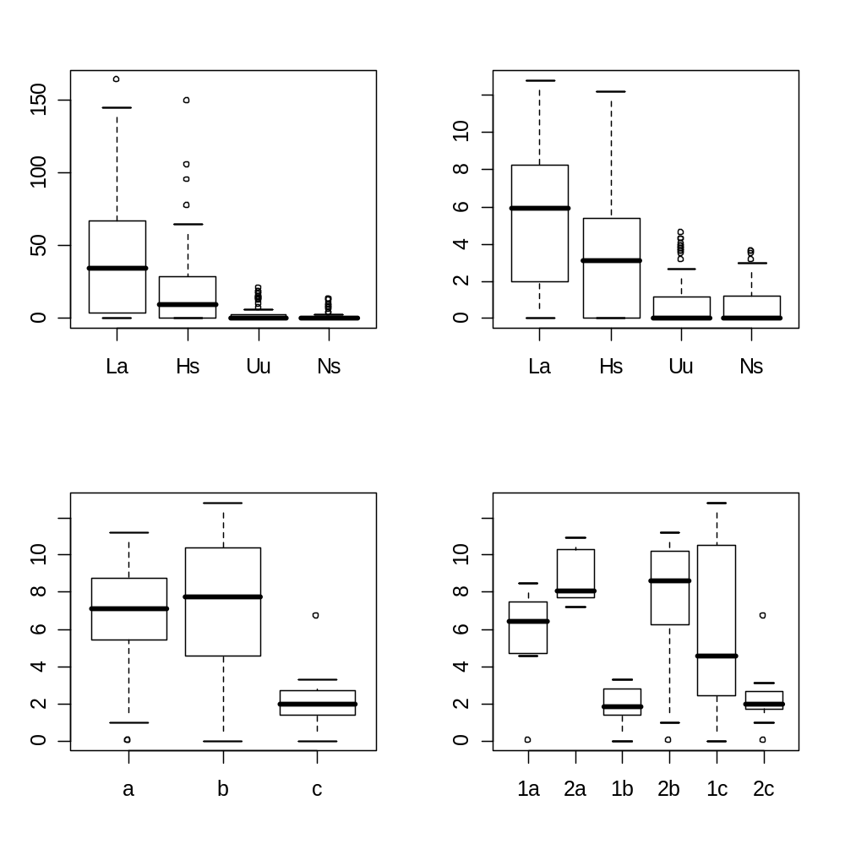
Conditional Boxplots
Comparisons of distributions among groups
Abundance
Sqrt(abundance)
Species
Species
Sqrt(abundance)
Sqrt(abundance)
Transect
Season
Advanced Stats
Exploration

Slide 27
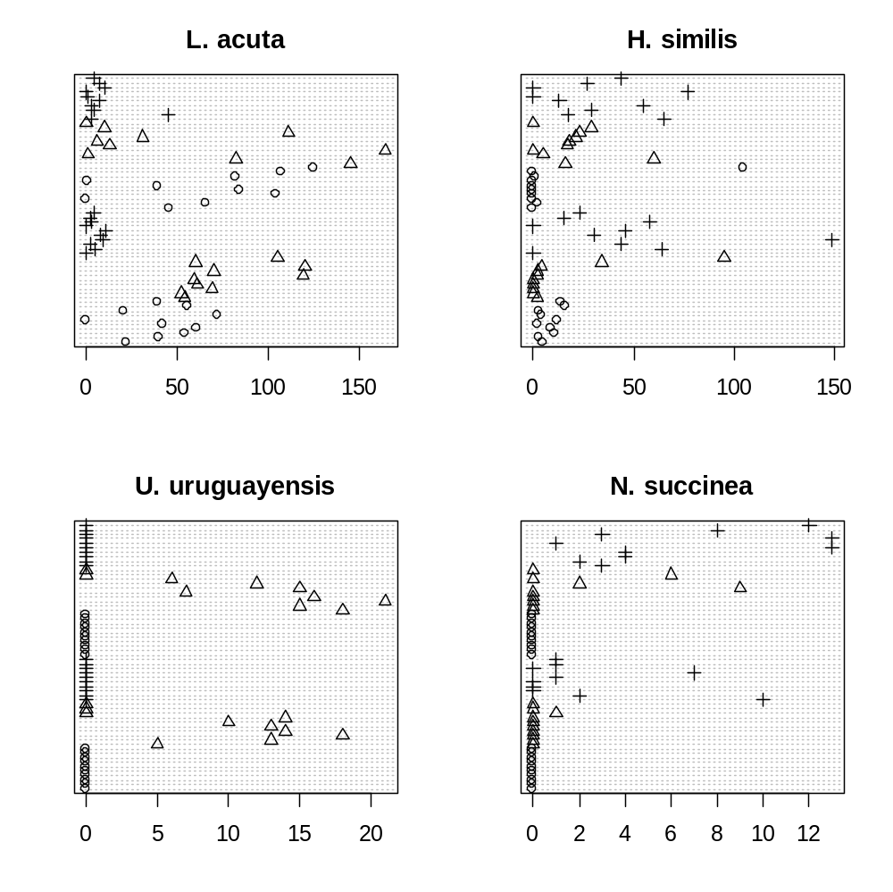
Cleveland Dotplots
Identify outliers and homogeneity.
X-axis are data values
Y axis is order of sample
(symbols are different transects)
Samples
Advanced Stats
Exploration

Slide 28
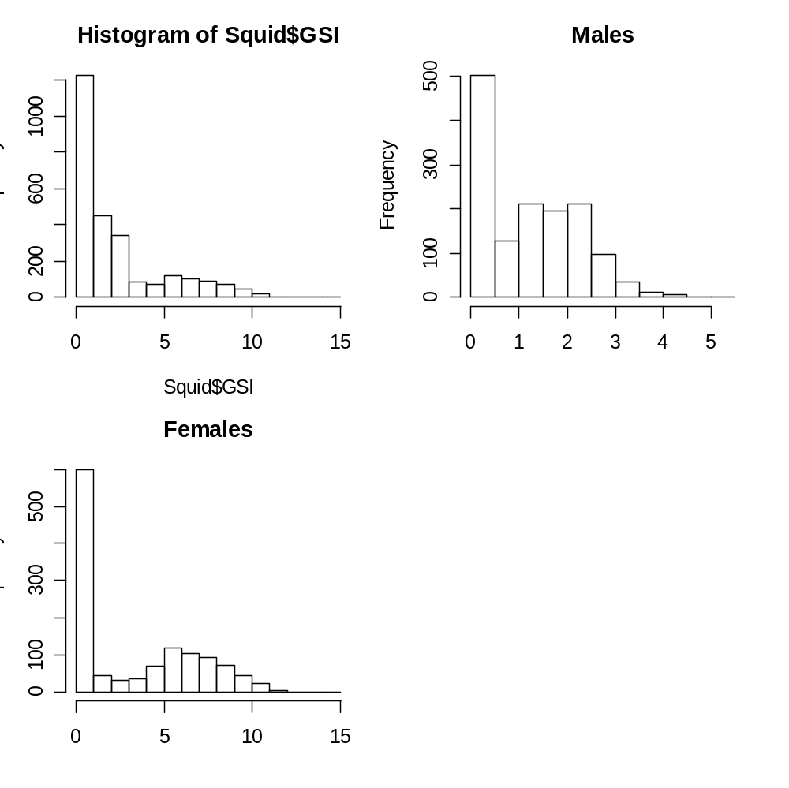
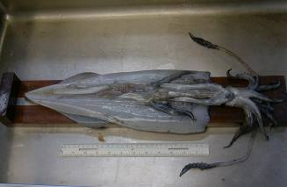
Histograms
Shows center and distribution
Conditional histograms show distribution by group
Frequency
Advanced Stats
Exploration

Slide 29
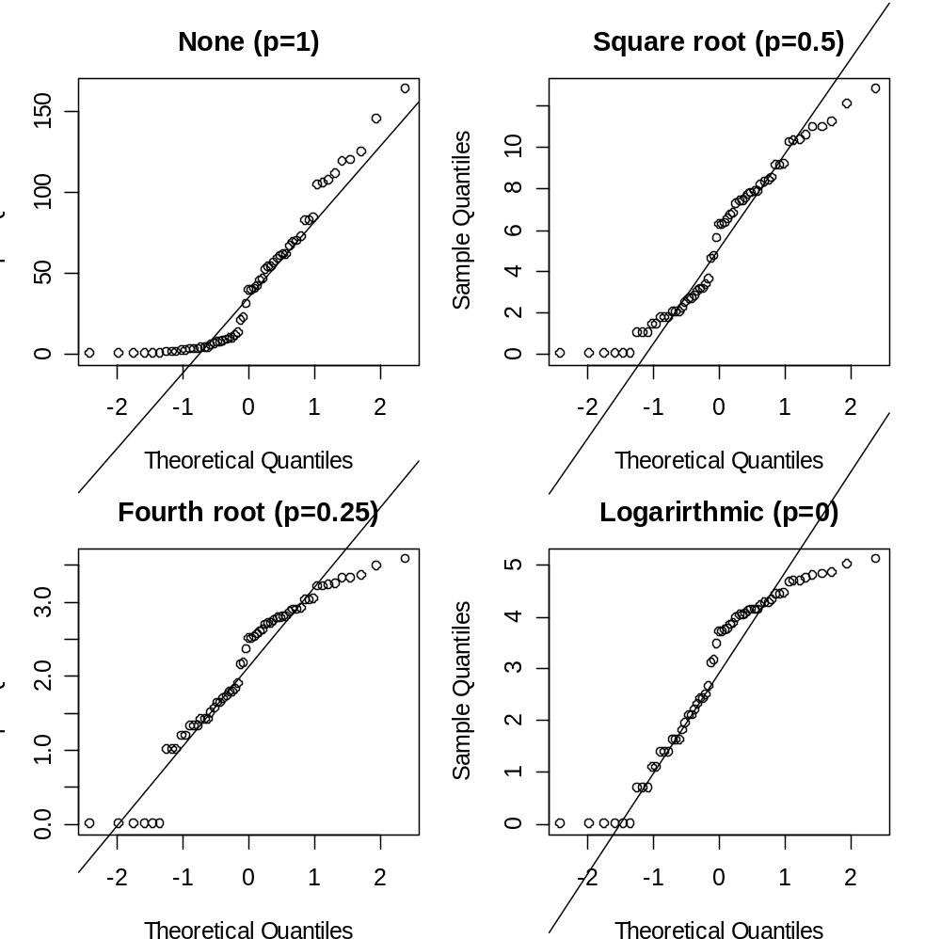
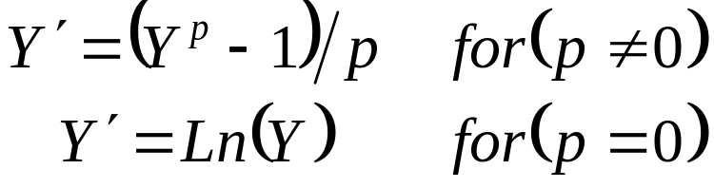
QQ-plot
Determines if data conform to a theoretical distribution.
Four alternative power transforms to achieve normality
Observed Quantiles
Advanced Stats
Exploration

Slide 30
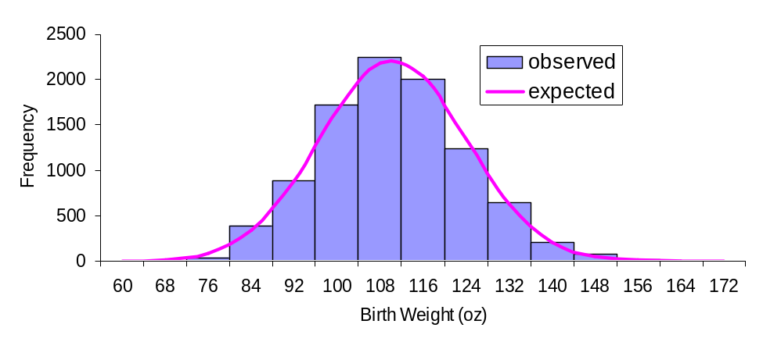
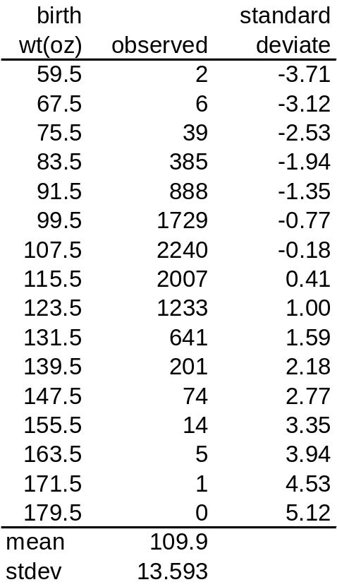
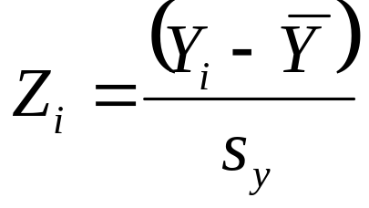
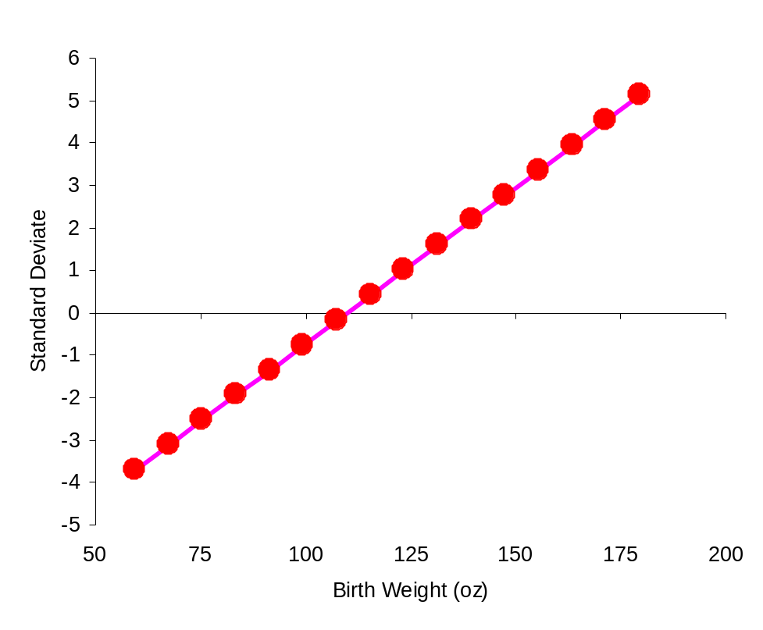
QQ-plot
Plot the observed data as standard deviates on observed values.
Advanced Stats
Exploration

Slide 31
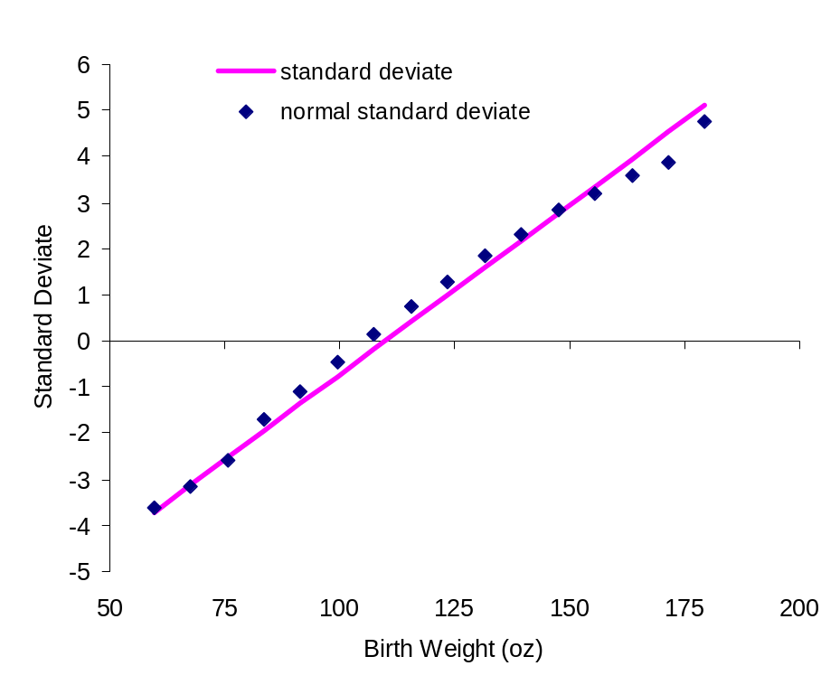
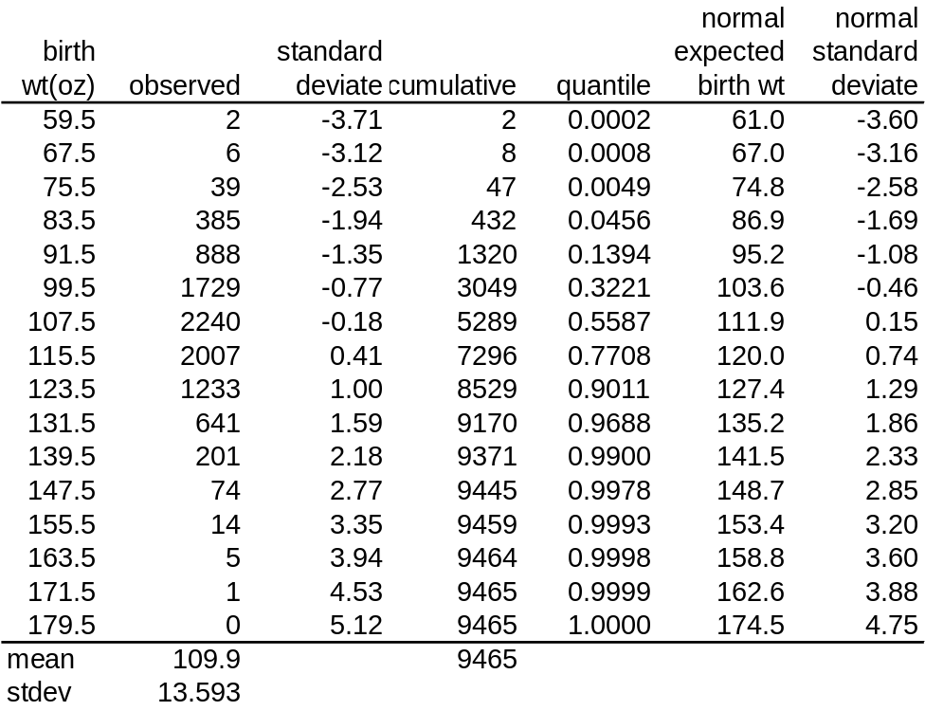
QQ-plot
Calculate cumulative frequency (cf) and quantiles (q)
  q=(cf-.5)/n
Derive expected normal standard deviate for each quantile
In Excel use =(norminv(q,mean,s)-mean)/s
Note switched axes
Advanced Stats
Exploration

Slide 32
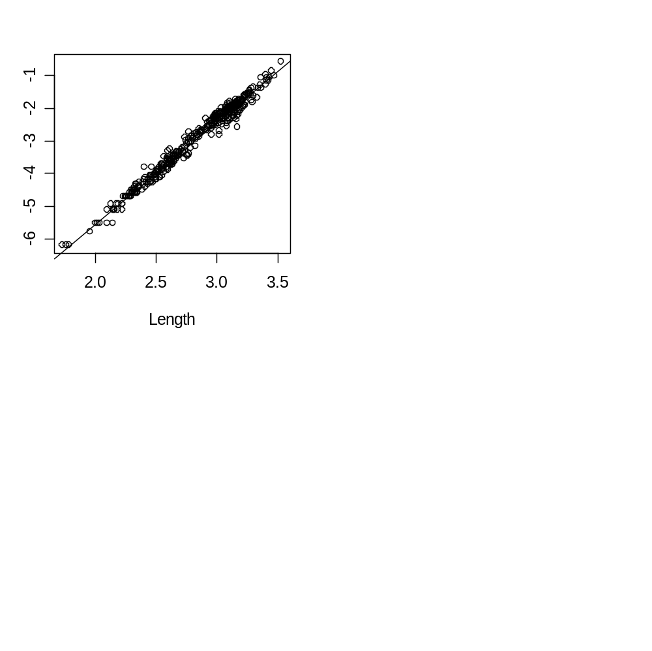
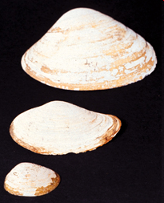
Scatterplot
Shows relationships between variables
Biomass
Advanced Stats
Exploration

Slide 33
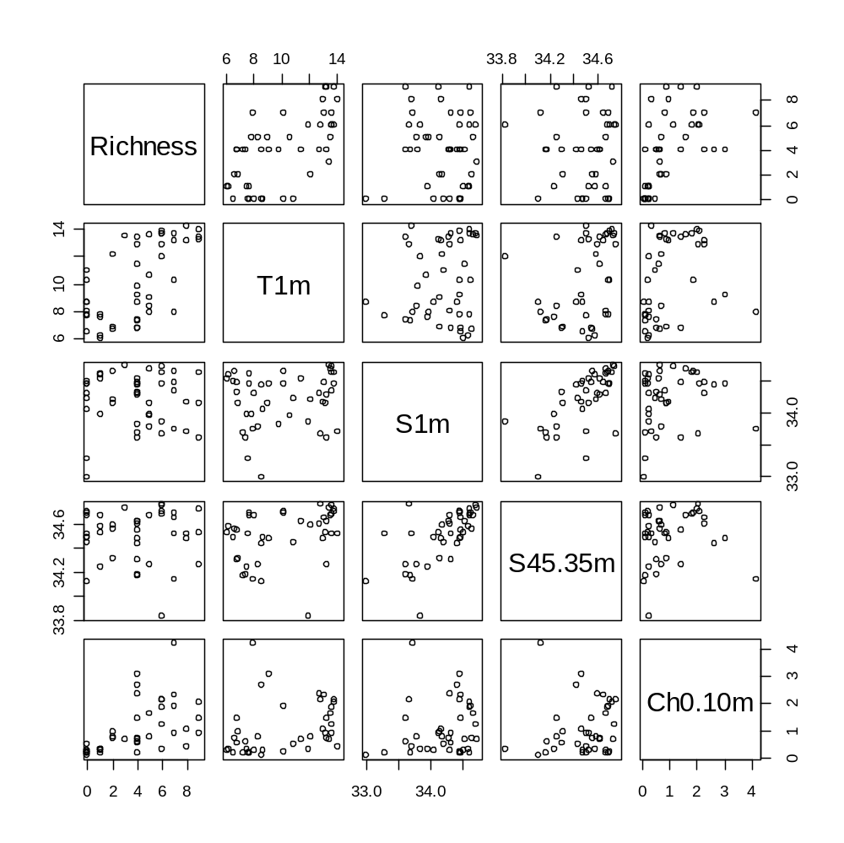
Pairplot
Series of scatterplots or scatterplot matrix for each pair of variables
  Species richness
  Temperature
  Surface salinity
  Bottom salinity
  Chlorophyll
Advanced Stats
Exploration

Slide 34
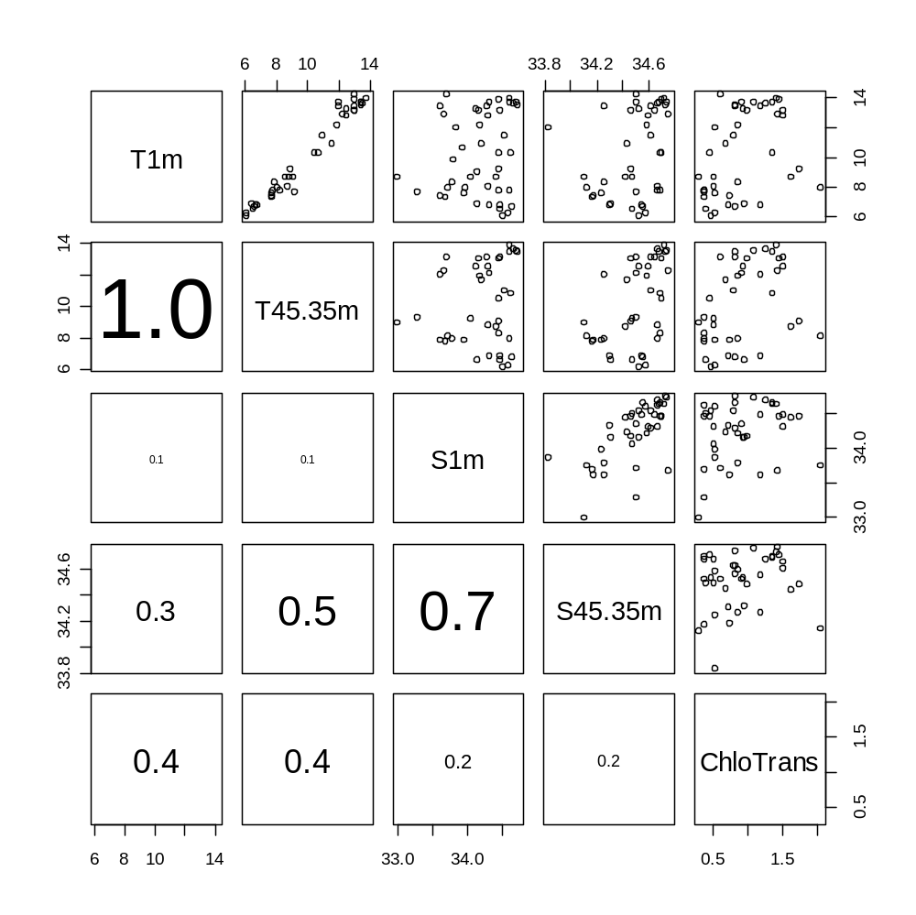
Pairplot
Measures of correlation
  Surface temperature
  Bottom temperature
  Surface salinity
  Bottom salinity
  Chlorophyll
Advanced Stats
Exploration

Slide 35
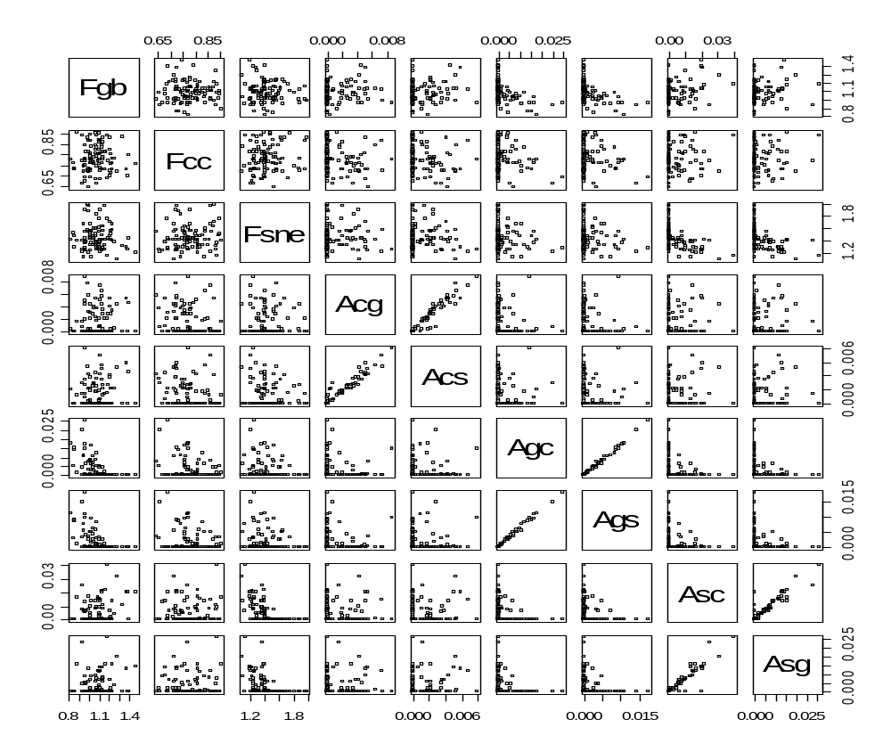

Pairplot
parameter covariance:
  Fishing mortality (F)
  Movement rates (A) among areas c, g and s
Advanced Stats
Exploration

Slide 36
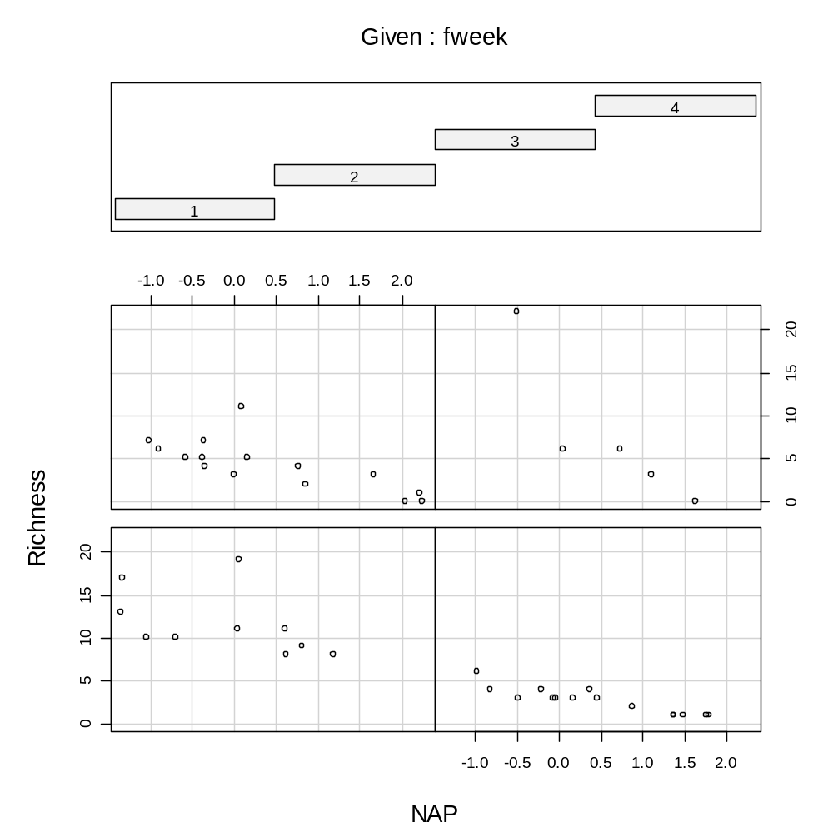
Coplot
Conditional scatterplot showing relationship of variables x and y for different values of a 3rd variable, z.
Species richness versus position relative to sea level over four weeks
4
1 2
Advanced Stats
Exploration

Slide 37
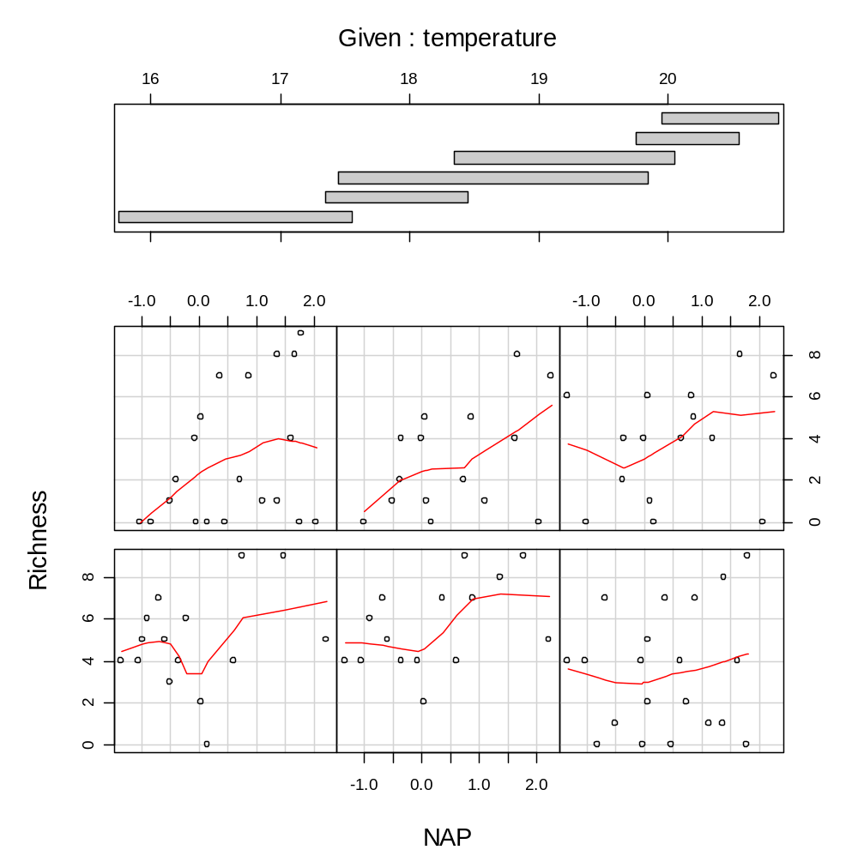
Coplot
If the z variable is continuous (temperature), some overlap in temperature ranges (equal sample sizes within overlapping groups).
Smoothing line added
Advanced Stats
Exploration

Slide 38
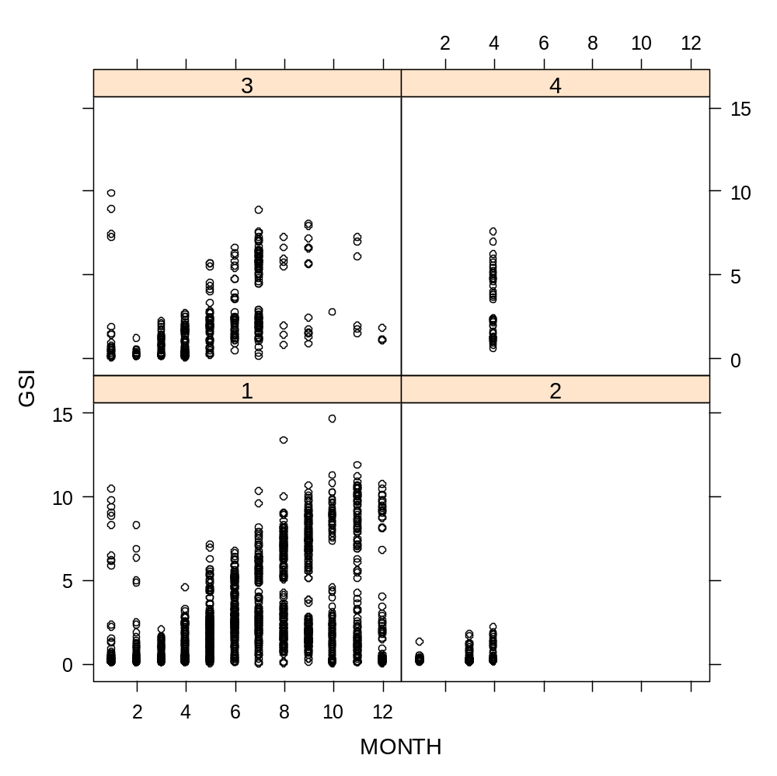
Lattice graph
(=Trellis graph)
shows relationship of variables x and y for different values of a 3rd variable, z.
Conditional variable (z) must be nominal (e.g., area)
Advanced Stats
Exploration

Slide 39
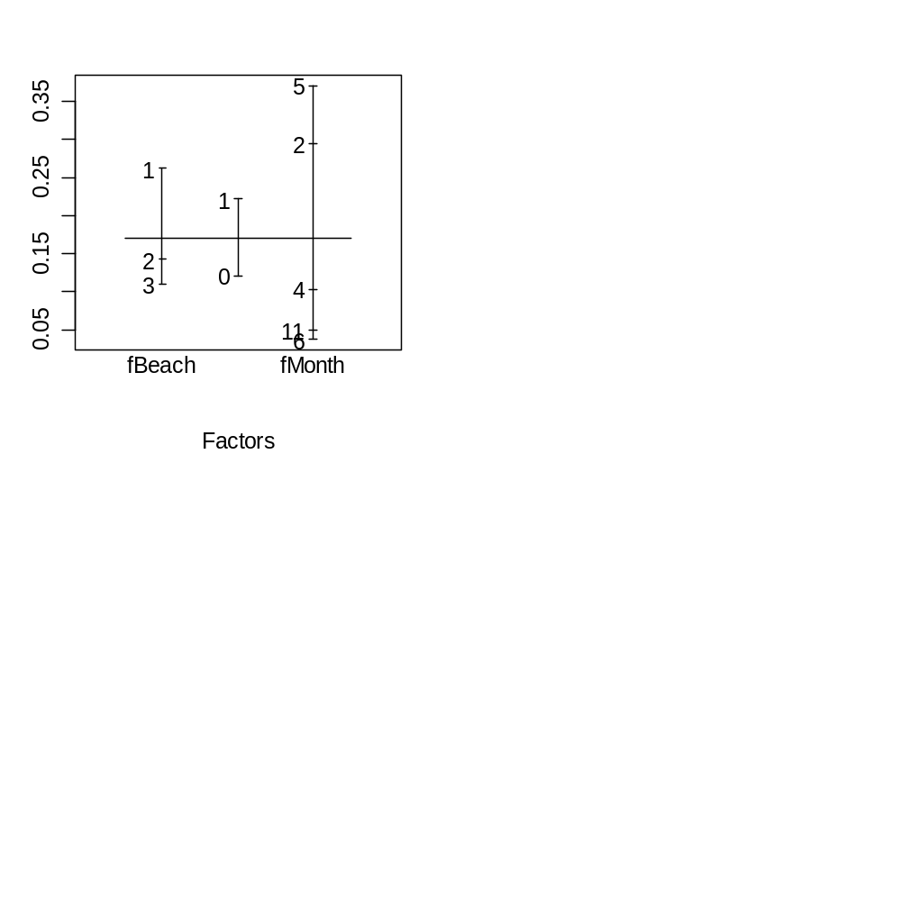
Design plot
Visualize differences in mean response variable at different levels of explanatory variables.
Mean abundance
Level
Advanced Stats
Exploration

Slide 40
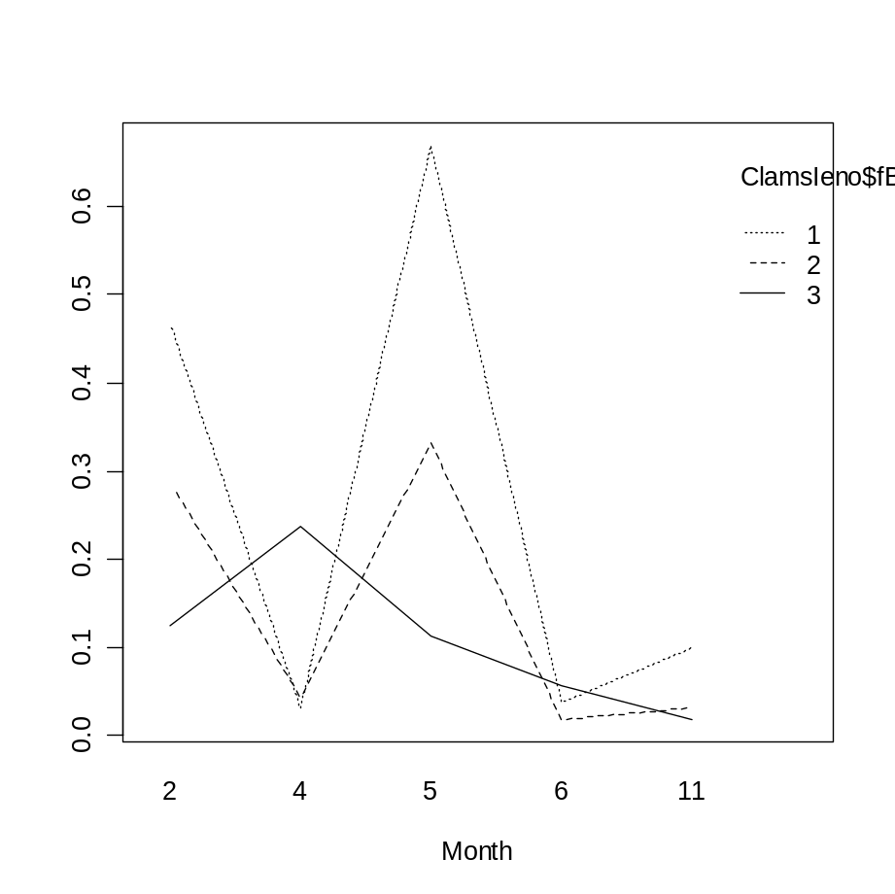
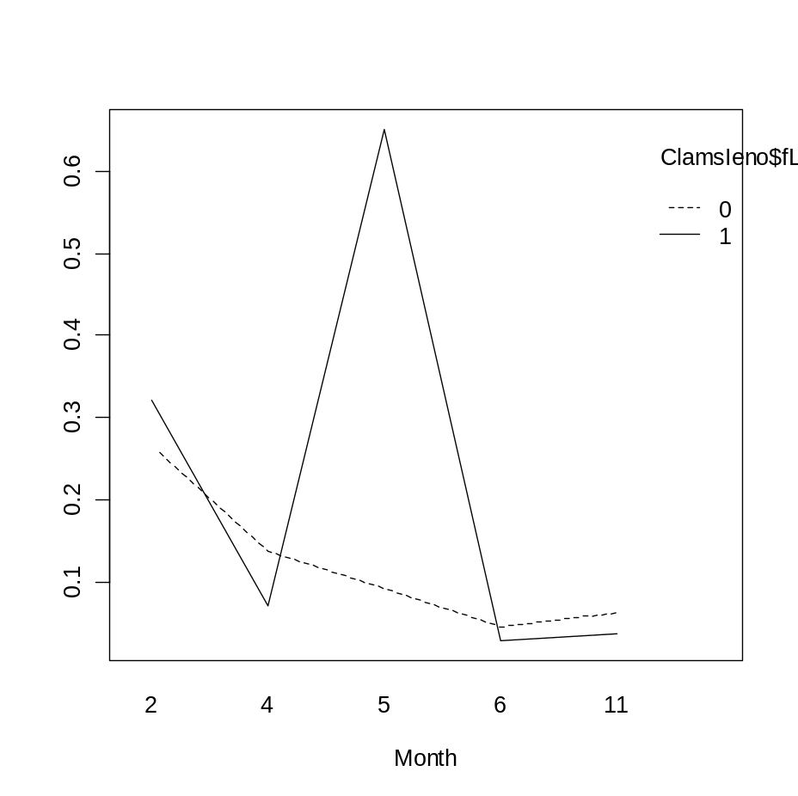
Interaction plot
Visualize interactions among explanatory variables:
  Month x beach - Month x level
Abundance
Abundance
Advanced Stats
Exploration

Slide 41
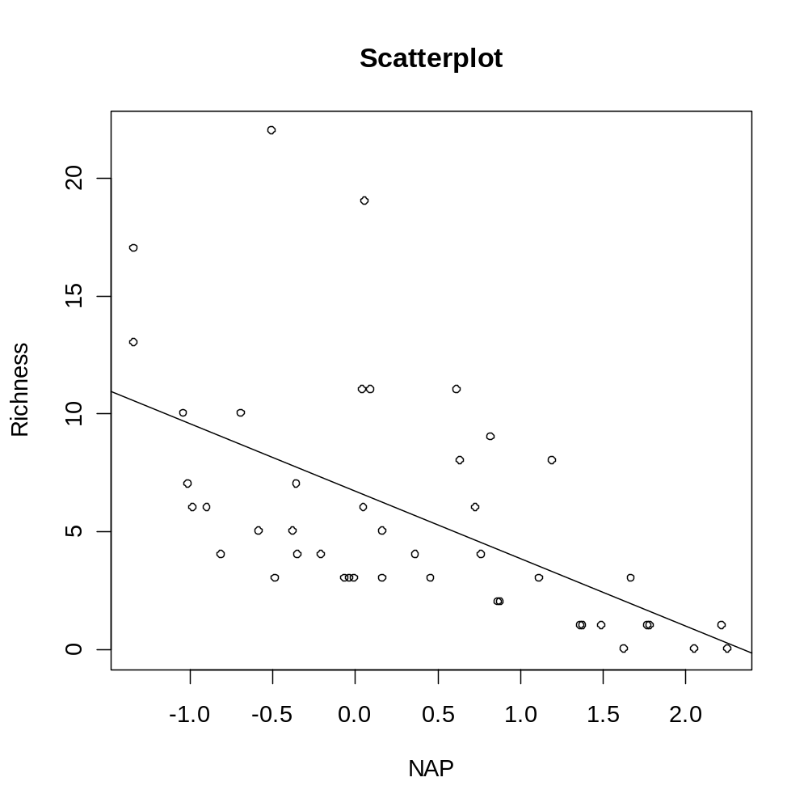
4.2 Outliers
Outliers are extreme values compared to the rest of the data that might incorrectly influence the analysis.
Outliers in xy space that are not outliers in x or y space.
First, make sure outliers are not data errors
Advanced Stats
Exploration

Slide 42
Transformation
Outliers, non-normality, heteroscedasticity and nonlinearity are the most common reasons for transformation.
Removing outliers is an option (with sensitivity analysis)
All response and explanatory variables can be transformed differently.
Choice of transformation depends on analytical design:
  GLS, GLM, GAM Poisson can handle outliers
  GAM and iterative least squares can handle nonlinearity
Advanced Stats
Exploration

Slide 43
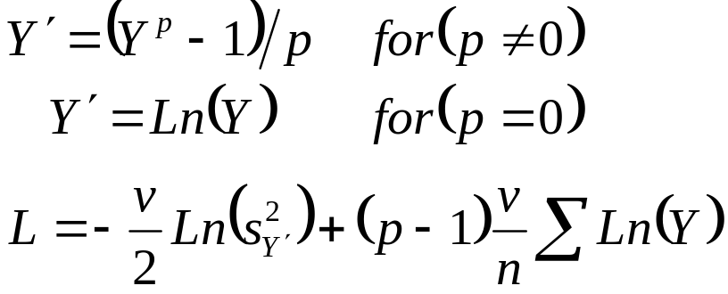
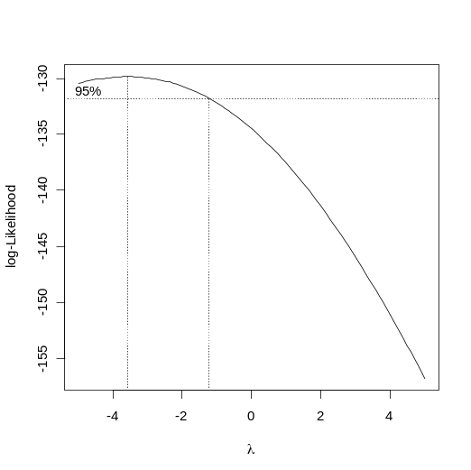
Nonlinearity
If scatterplot indicates nonlinear patterns, consider transforming one or both variables.
Box-Cox series of possible univariate transformations:
  p=-1 reciprocal transformation
  p=0 log transformation
  p=0.5 square root transformation
  p=1 linear transformation
  phat the most likely transformation
  (automatic univariate transform)
0-1 transform (e.g., presence; absence)
Rank transform
Advanced Stats
Exploration

Slide 44
Choosing the Right Transform
Trial & Error: dotplots, boxplots, pairplots, …
Mosteller & Tukey’s bulging rule indicates the appropriate transformation in the Box-Cox series – increasing or decreasing the x or y to make the relationship linear:
y², y³
Log(x), x^{0.5}, x^{0.3}
x², x³
Log(y), y^{0.5}, y^{0.3}
Advanced Stats
Exploration

Slide 45
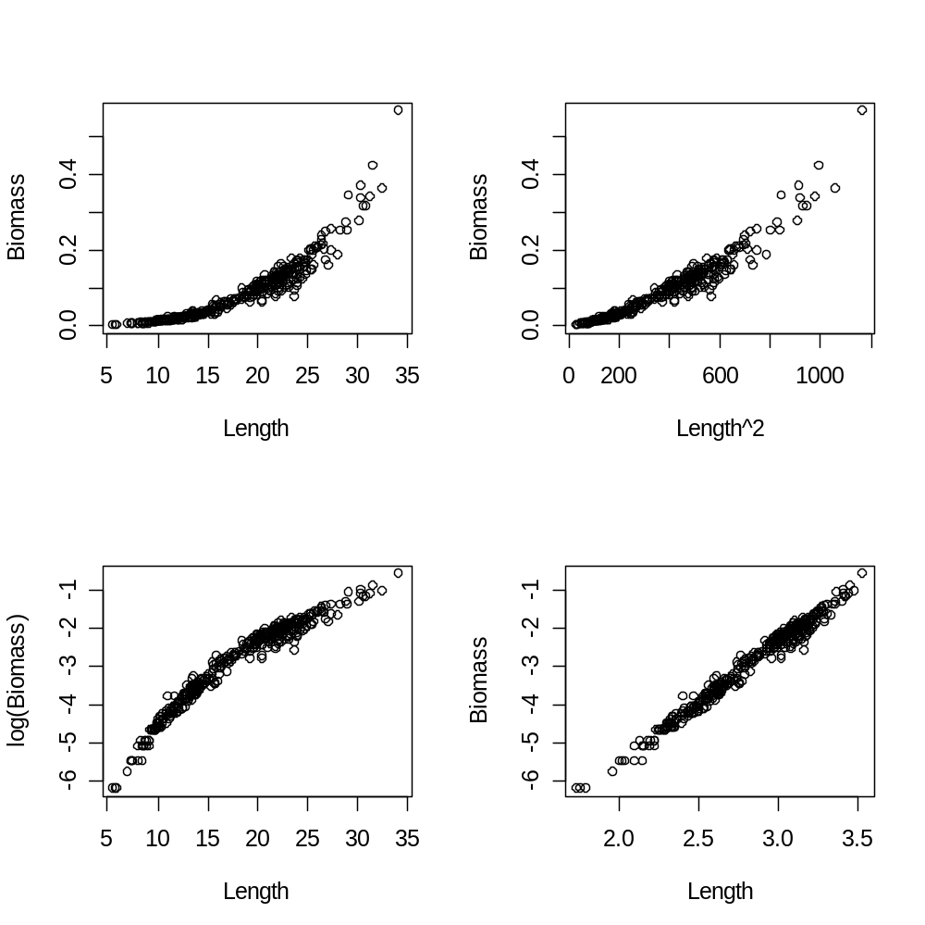
Bulge Rule
Bulge down to the left suggests increasing x and decreasing y.
Advanced Stats
Exploration

Slide 46
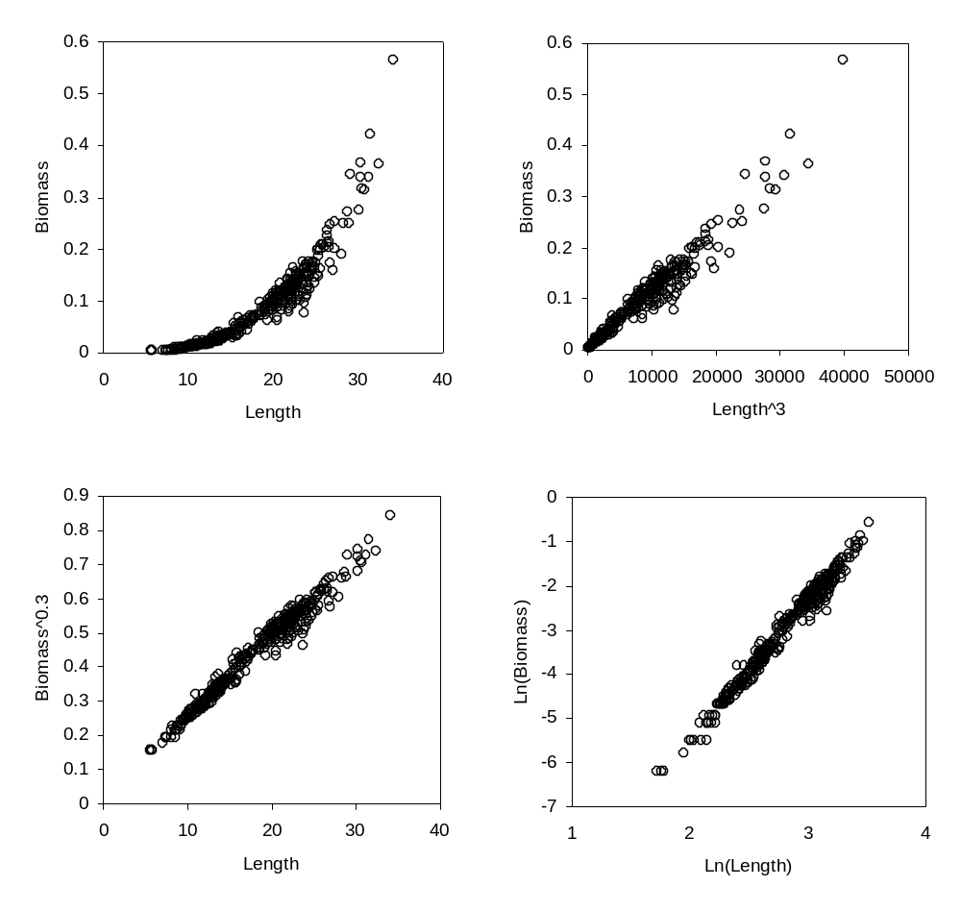
Empirical vs. Theoretical Transforms
There’s also a theoretical transform for the clam data:
  Length is a linear dimension, and biomass is a volumetric dimension
    B~L³
    B^{0.3}~L
  multiplicative growth
    B=aL^{b}
    Ln(B)=Ln(a)+bLn(L)
Advanced Stats
Exploration

Slide 47
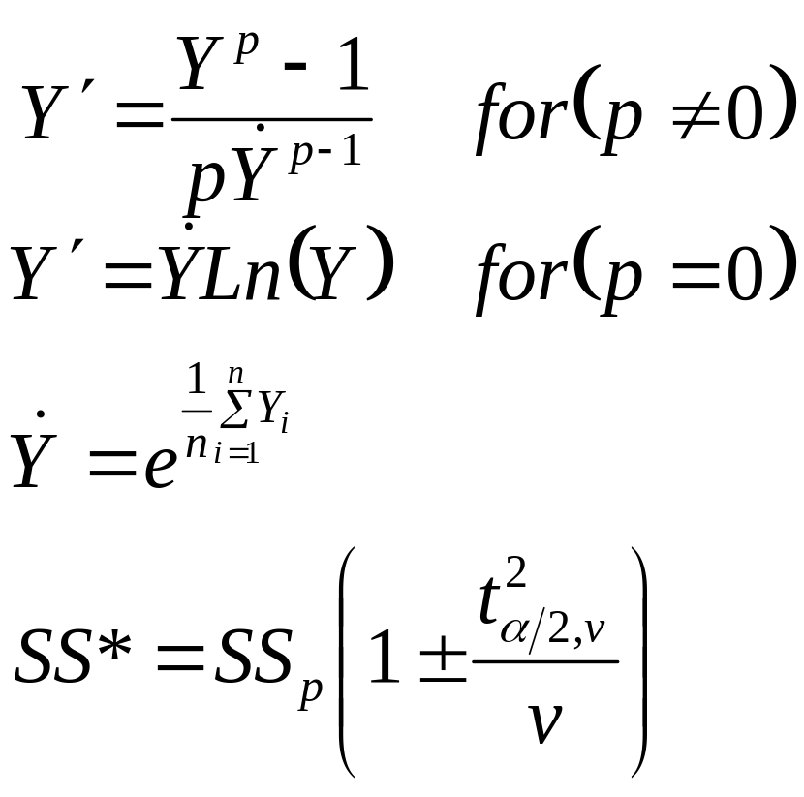
Automatic Bivariate Transformation
Series of power transforms judged based on residual sum of squares from regression (adjusted for comparison among transformed units by the geometric mean, Ydot)
  SS_{p} is the minimum
  SS* is the confidence interval
Advanced Stats
Exploration

Slide 48
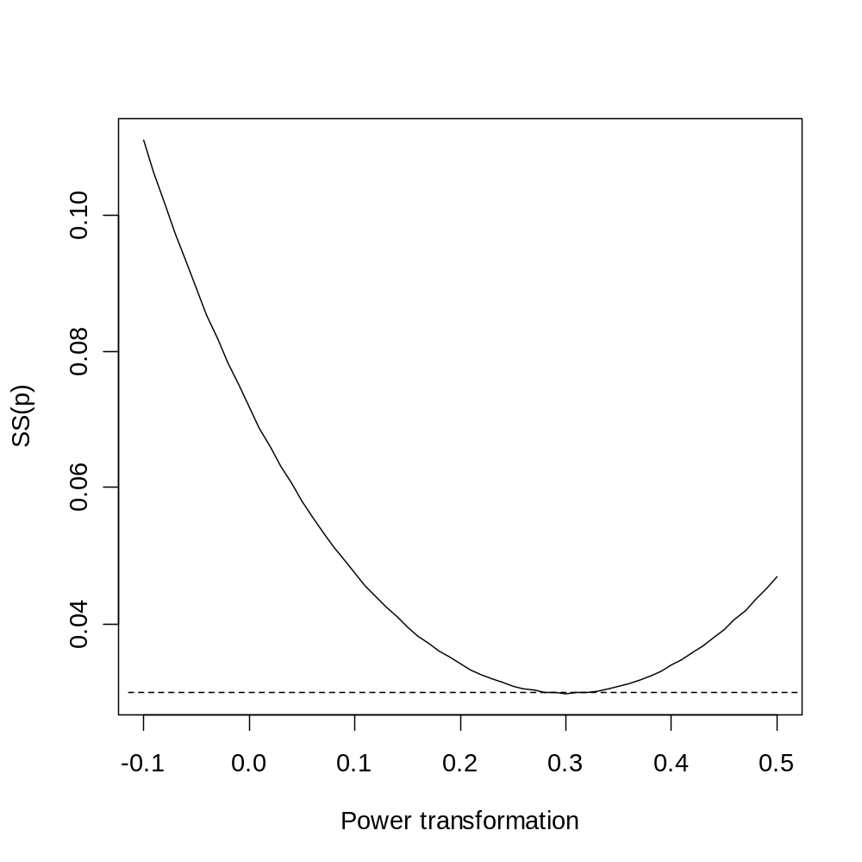
Automatic Bivariate Transformation
The optimal transform for the clam data is a power of ~0.3 (the confidence limit includes the theoretical expectation).
Expressed as p, the confidence limit of p (0.005-0.035) includes zero – the Ln transform.
Note different output from book
Advanced Stats
Exploration

Slide 49
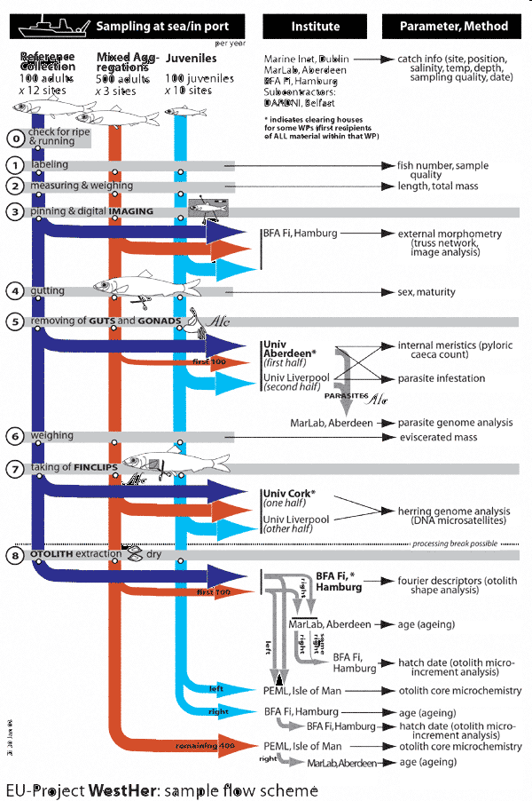

Multivariate
Transformations
If data are of the same type, a common transform should be used.
Different types of response variables may require different transformations.
WESTHER is an interdisciplinary stock identification project:
  Parasite counts (sqrt)
  Morphometrics (size-filtered)
  Chemistry (log)
Advanced Stats
Exploration

Slide 50
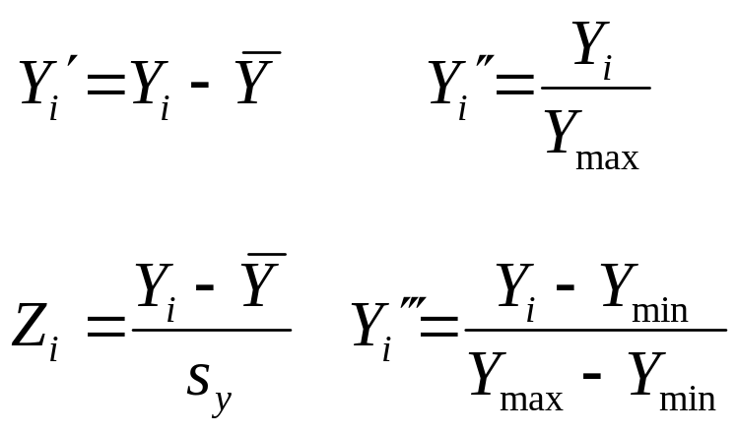
Standardizations
If variables for comparison are on different scales, conversion to a common scale may be an option.
Some analyses (e.g., correlation, PCA) are self- standardized.
Centering (standard ‘location’):
  Ybar: mean
Normalizing (standard ‘spread’):
  s: standard deviation
Advanced Stats
Exploration

Slide 51
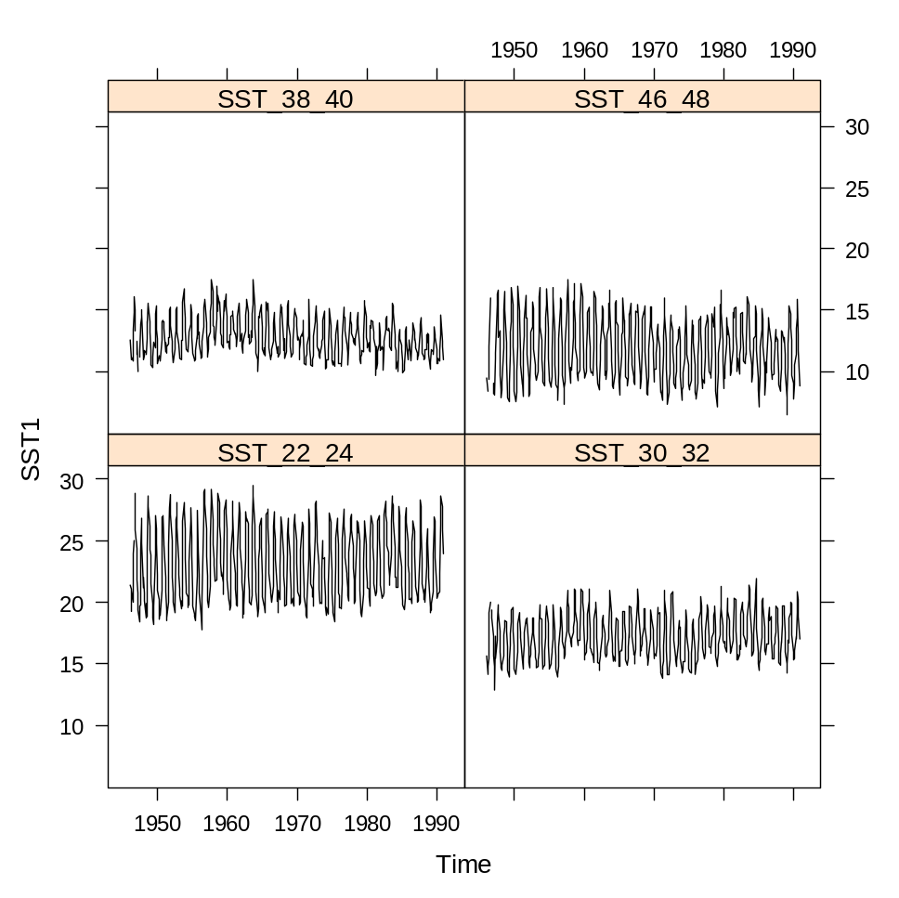
Sea Surface Temperatures by Latitude
Differences in temperature (ºC) can be easily seen with average and range, but patterns are difficult to compare, because of different scales
Advanced Stats
Exploration

Slide 52
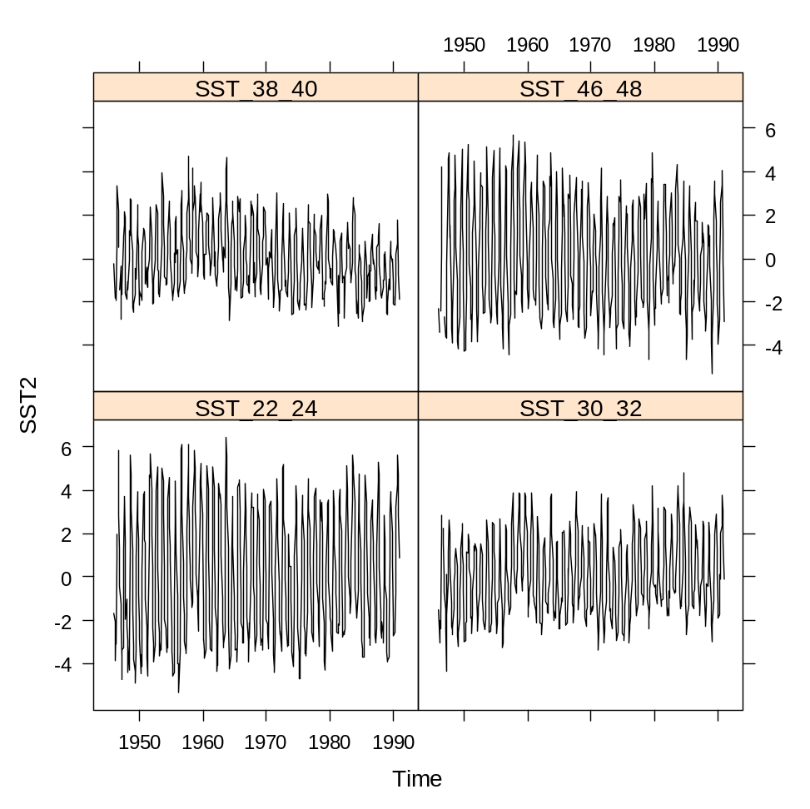
Sea Surface Temperatures by Latitude
Centered by subtracting mean (anomalies in ºC)
Advanced Stats
Exploration

Slide 53
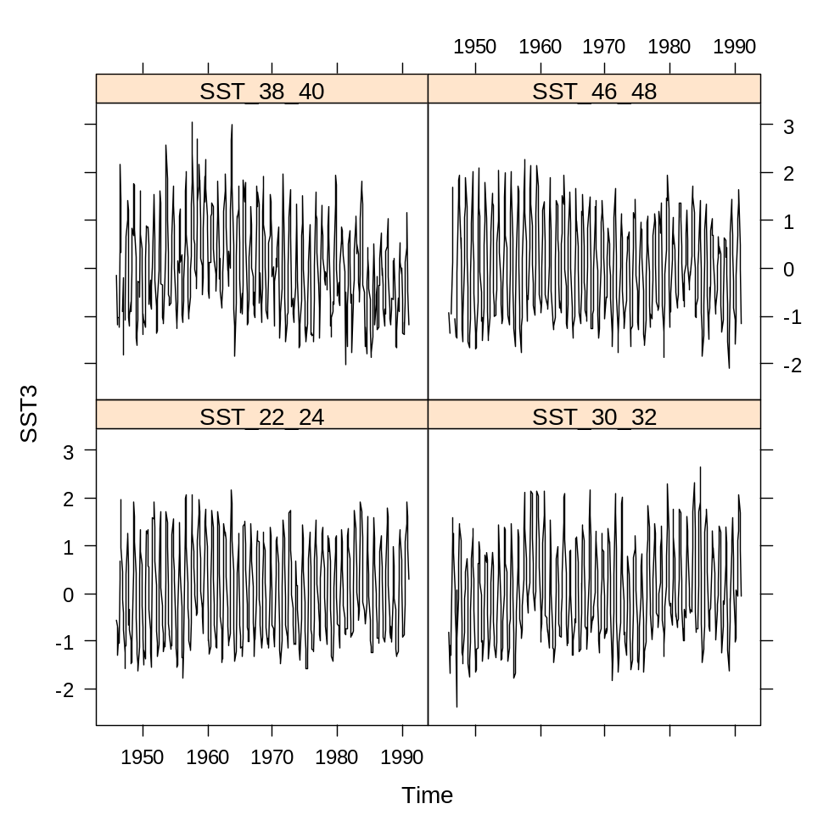
Sea Surface Temperatures by Latitude
Normalized (anomalies in standard deviation units)
Advanced Stats
Exploration

Slide 54
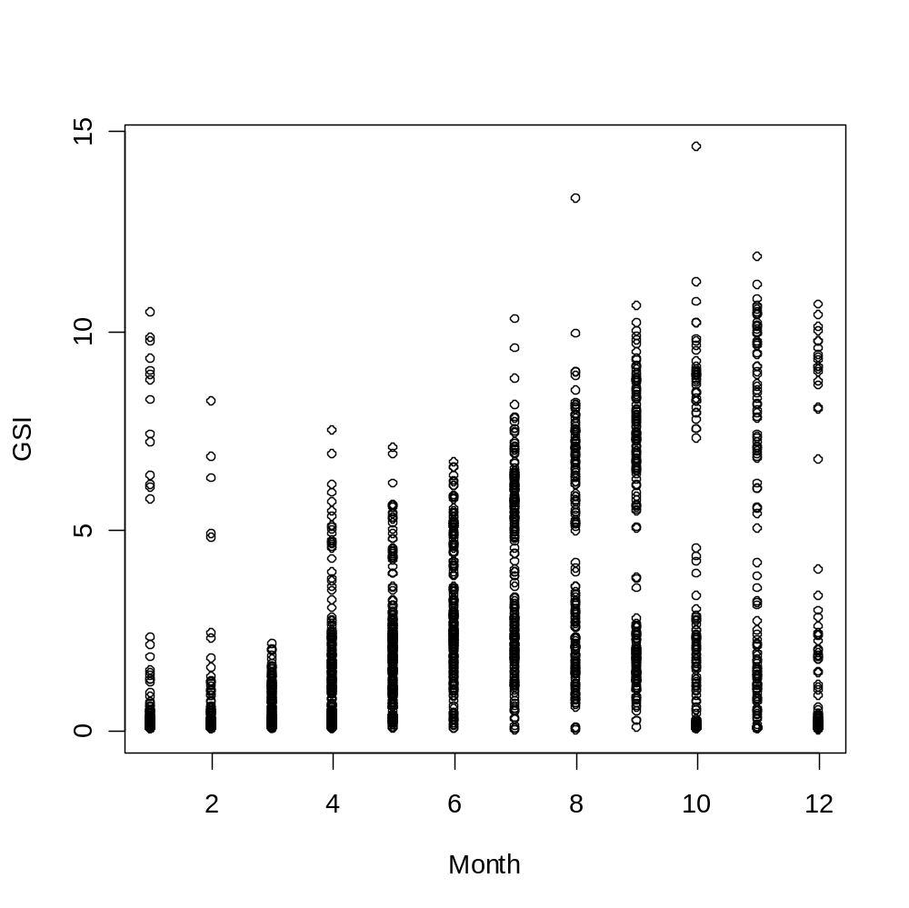
Exploring Relationships
‘Even if you don’t see it, it might still be there.
Squid GSI data don’t appear to have a relationship with month.
Advanced Stats
Exploration

Slide 55
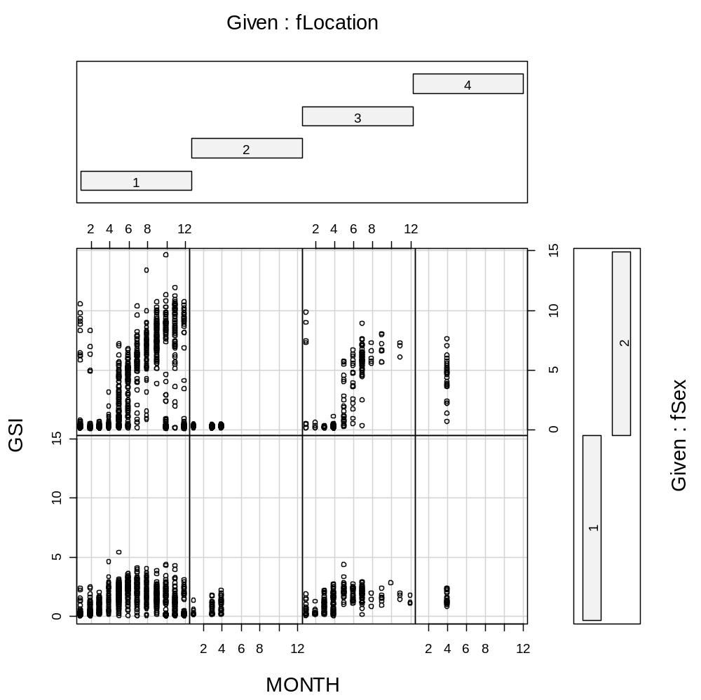
Exploring Relationships
When GSI-month relationships are disaggregated by gender and area, some interesting patterns emerge.
Advanced Stats
Exploration

Slide 56
3.1 Overview of Bivariate Methods
Transformation
- response variable?
explanatory variable?
- residuals?
Normality
- histograms
- Q-Q plots
Collinearity
- pairplots
PCA
coplots
Lattice plots
Data
Exploration
Outliers
- dotplots
- boxplots
Linear relationships
Nonlinear relationships
Linear
Regression
Additive
Modeling
Verify linearity or nonlinearlity
violation of
homogeneity
violation of
homogeneity
Generalized
Linear Modeling
Generalized
Additive Modeling
Advanced Stats
Introduction

Slide 57
Predictive Models
Linear
Regression
Homogeneous residuals, No residual patterns
Normal residuals, Independent residuals
Residual patterns
Additive
Modeling
Independent residuals
Spatial dependence
Temporal
dependence
Simultaneous Autoregressive Model
Simultaneous Moving Average Model
Linear Model with Correlated Error
Kriging
- Generalized Least Squares
- Time Series Analysis
Advanced Stats
Introduction

Slide 58
Summary
Reasons for data transformation:
  Reduce effect of outliers
  Improve linearity between variables
  Make error structure closer to normal
  Stabilize relationship between mean and variance
General approach:
  Apply all explorations to raw data
  If explanatory data have outliers, then transform
  Apply analytical technique and explore residuals
  If residuals have outliers, heterogeneity or patterns, then transform
  Choose the best transformation by trial & error, automatic selection or rules of thumb (e.g., sqrt for counts, arcsin for proportions, log for multiplicative relationships)
Advanced Stats
Exploration

Slide 59
Schedule of Lectures – Part 1
Type | Day | Date | Reading | Topic | Presenter
Lecture | Tue | Jan 26 | Zuur et al. Chap. 1-4 | Introduction, data exploration | Steve
Lab | Wed | Jan 27 |  | Introduction to R and R Studio, working with data | Gavin
Lecture | Thur | Jan 2 | Bolker 2008 Chap. 4 | Probability review | Gavin
Lecture | Tue | Feb 2 | Zuur et al. Chapter 5 | Linear regression review | Steve
Lab | Wed | Feb 3 |  | Introduction to plotting, manipulating data | Gavin
Lecture | Thur | Feb 4 | Zuur et al. Section 6.1 | Extending linear model (GLM) | Steve
Lecture | Tue | Feb 9 | Zuur et al. Section 6.2 | Classification, Logistic regression | Steve
Lab | Wed | Feb 10 |  | Probability, Linear modeling in R, PCA. | Gavin
Lecture | Thur | Feb 11 | Zuur et al. Chapter 12 | Matrix algebra review and PCA | Steve
Wednesday Lab – Introduction to R & R Studio
Thursday Lecture - Probability
Advanced Stats
Introduction

